Slide 1
RNN or Transformer
RWKV新结构解析

Slide 2

从RNN到LSTM

Slide 3

从RNN到LSTM

Slide 4
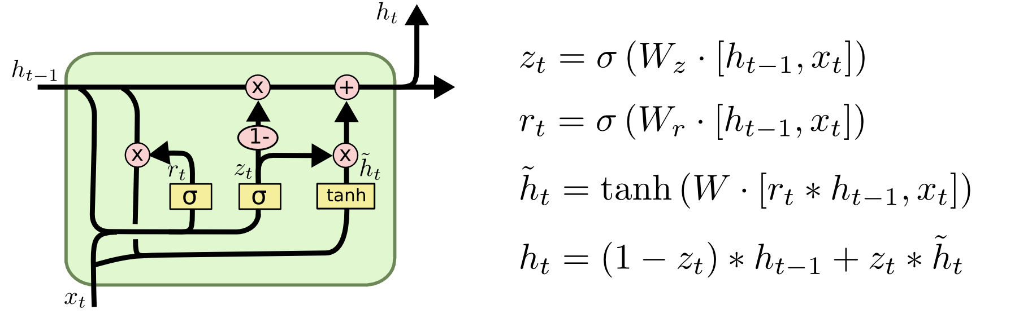
GRU

Slide 5
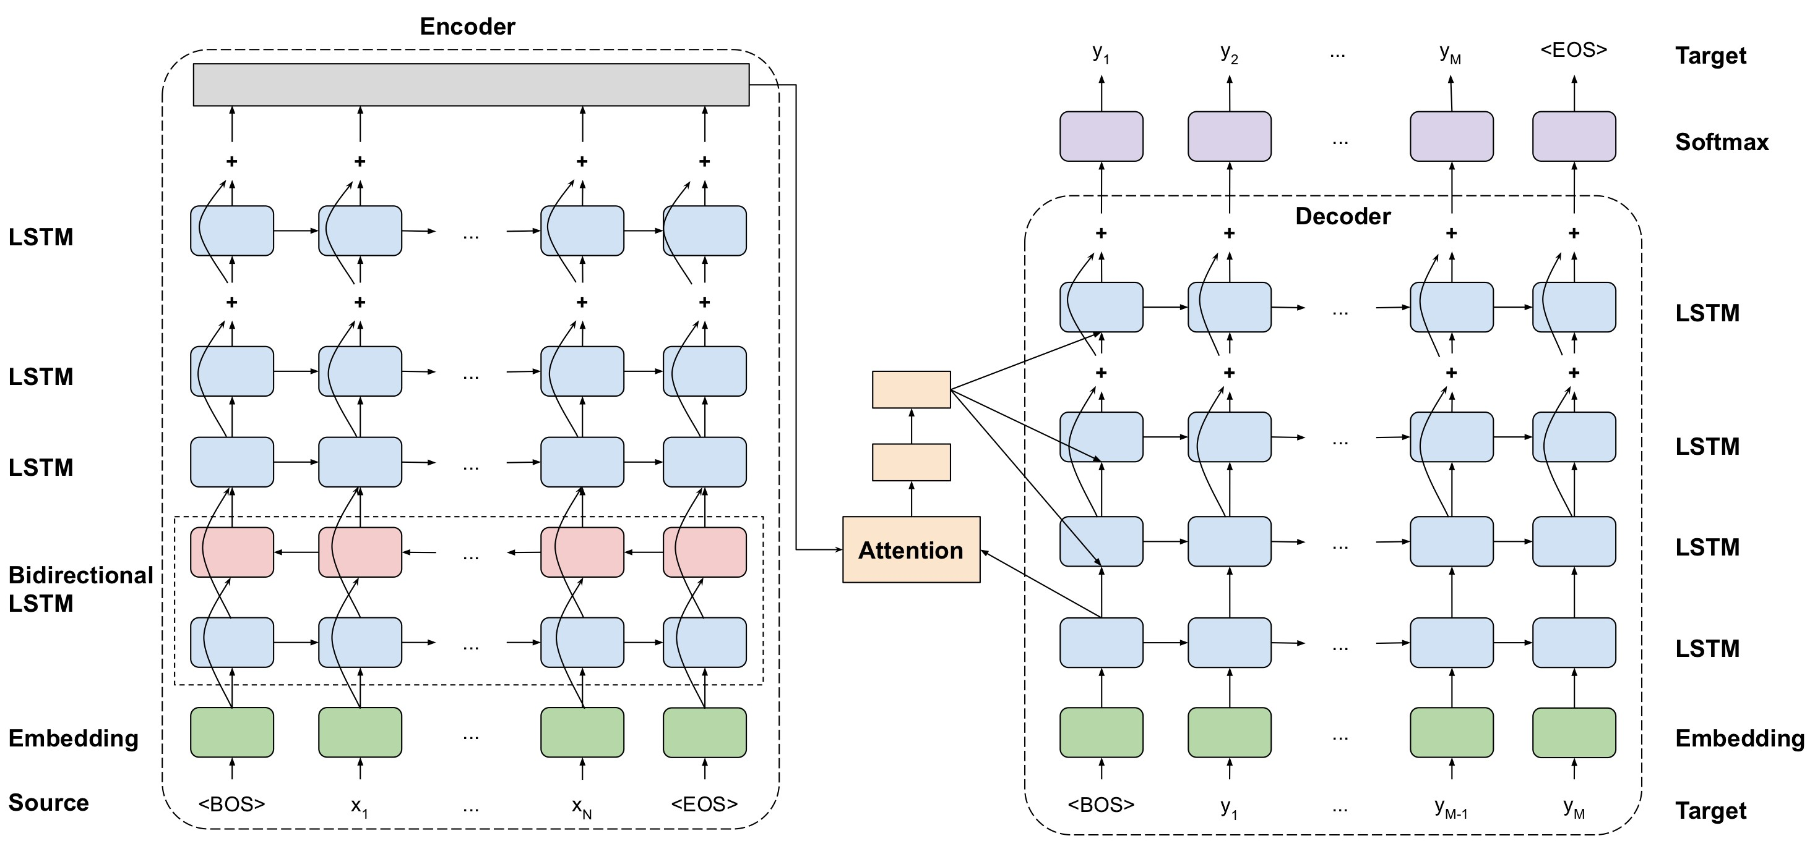
GNMTv2

Slide 6

Attention is all you need
• RNN不能并⾏训练问题
• 参数量
• 信息抽取能⼒

Slide 7
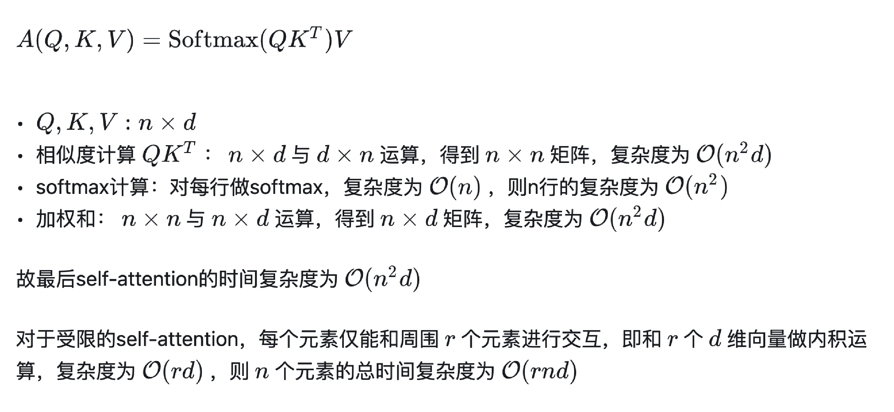
Self-attention复杂度

Slide 8
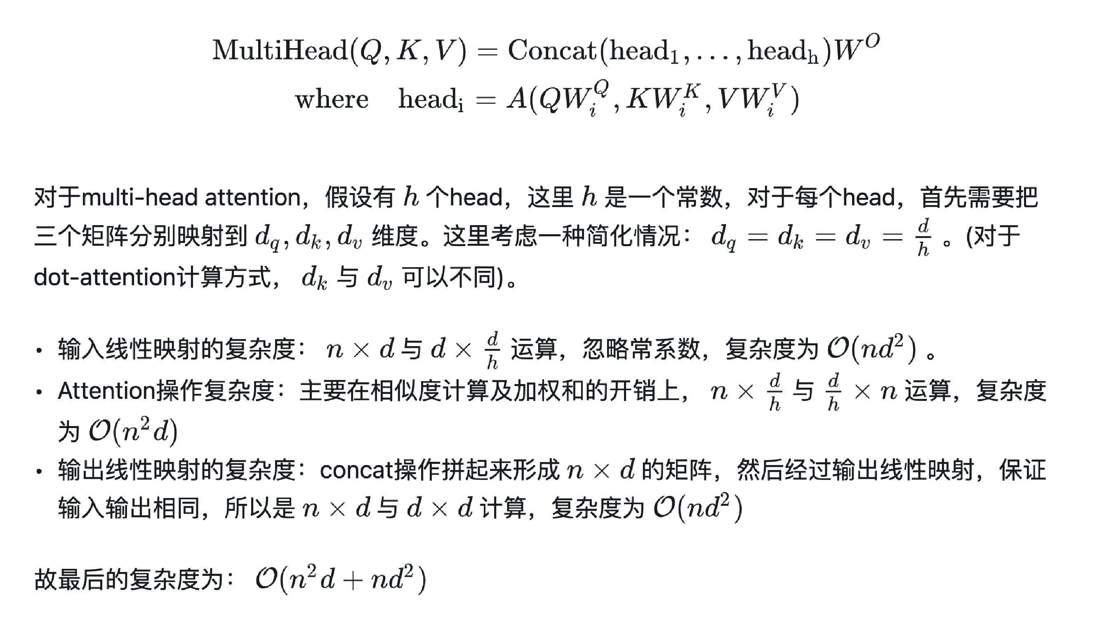
Multi-head attention复杂度

Slide 9
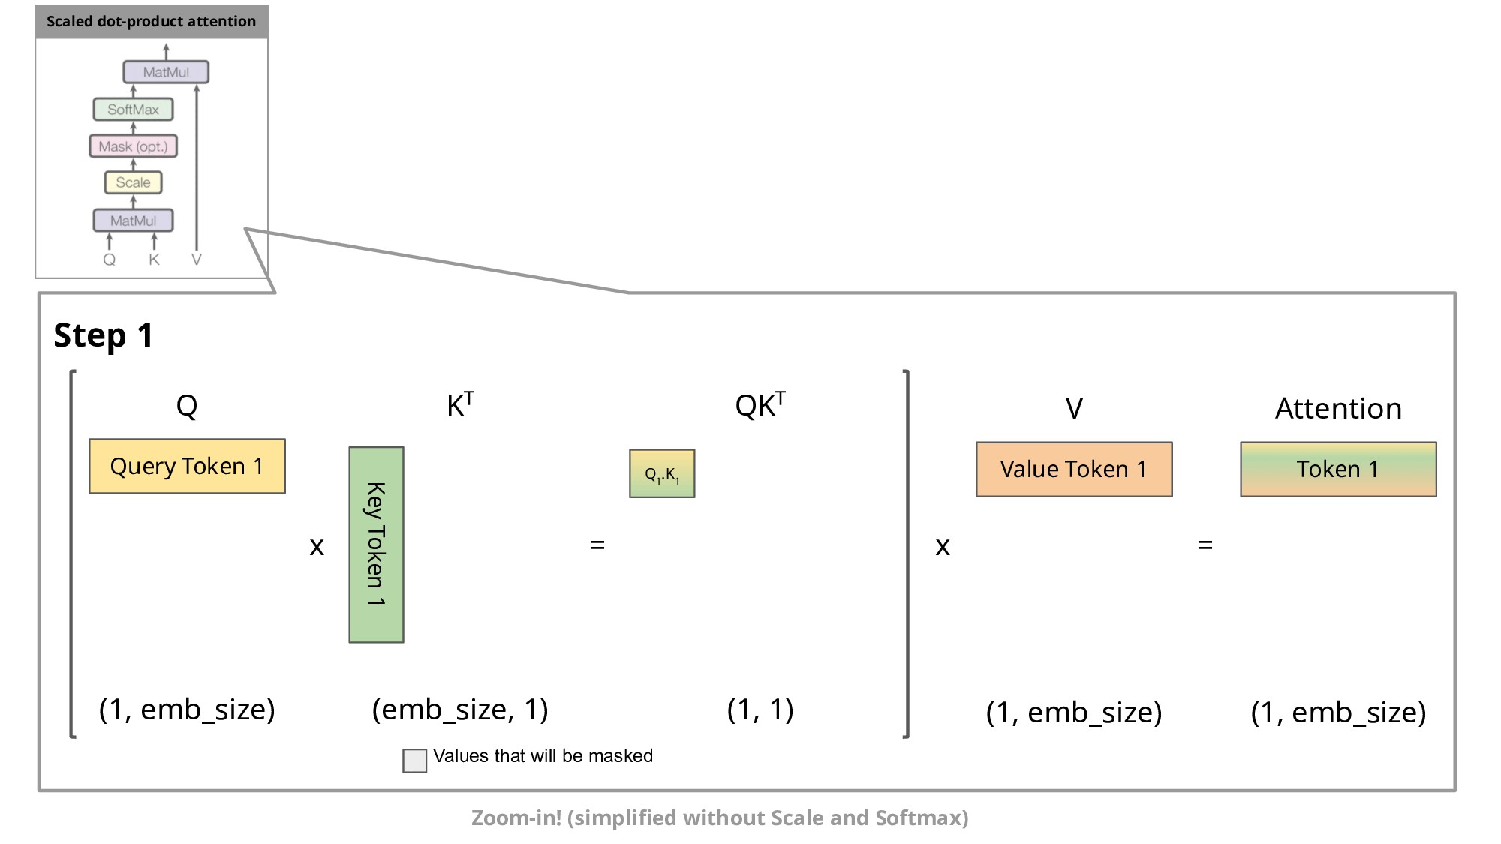
推理效率问题

Slide 10
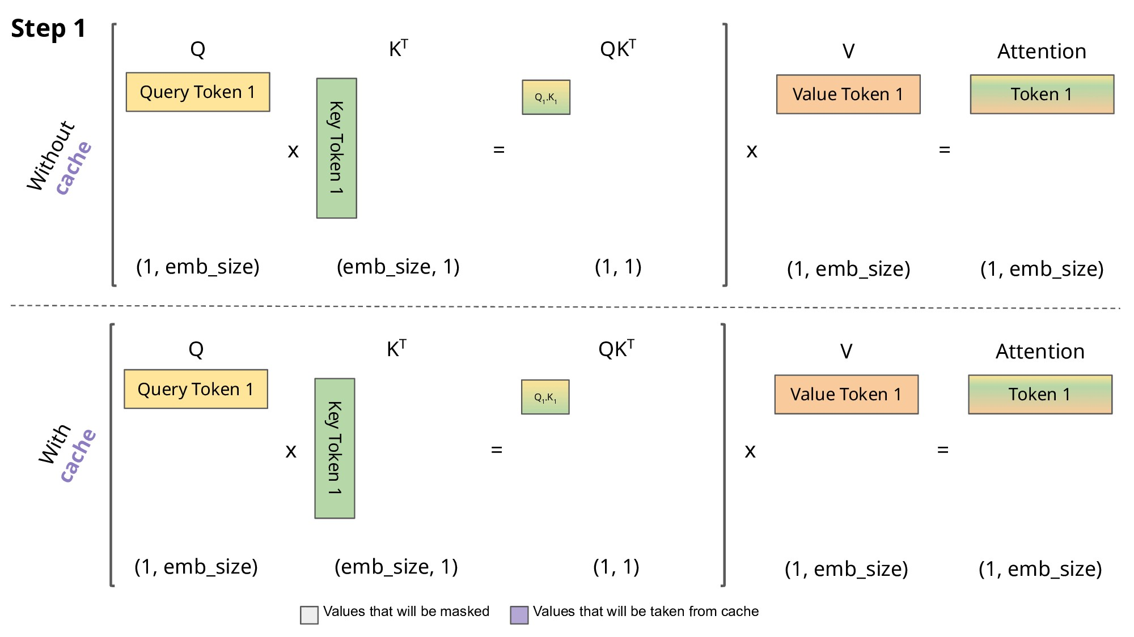
KV Cache

Slide 11
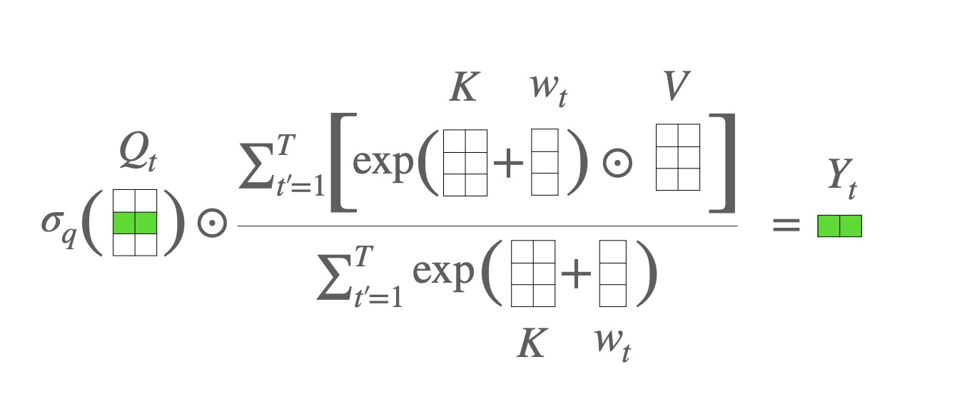
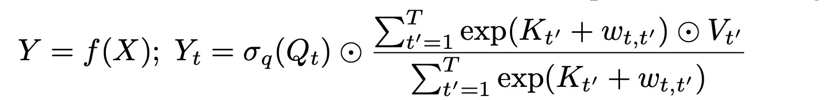
Attention Free Transformer

Slide 12
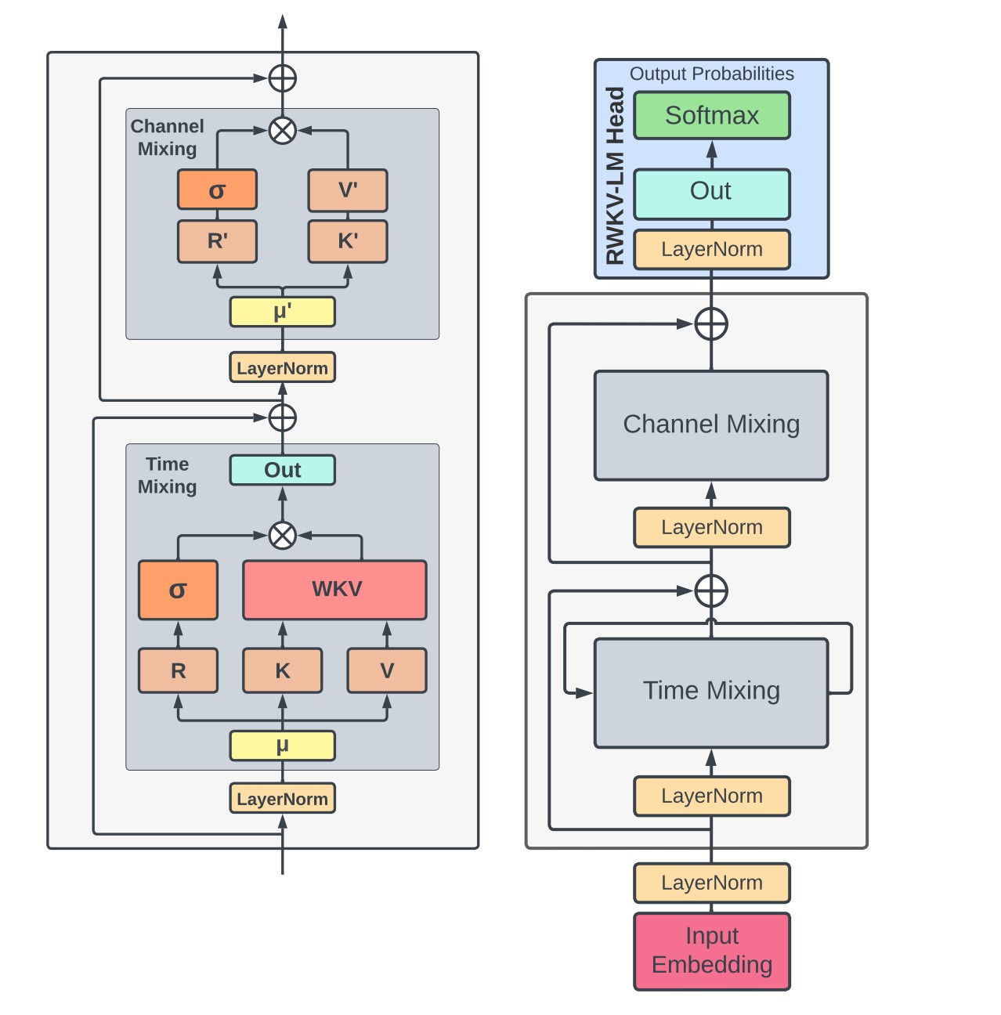
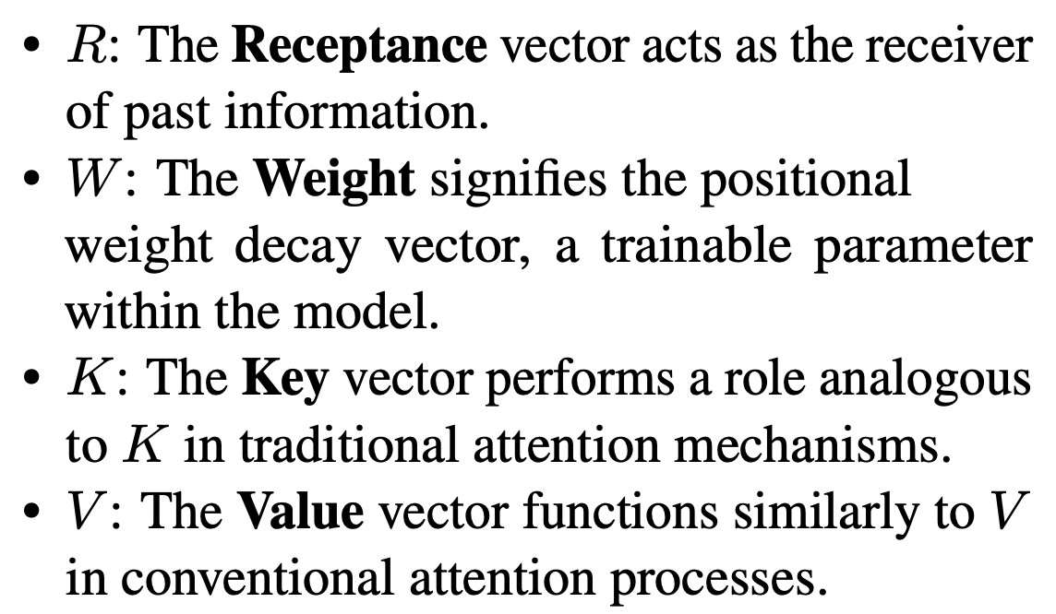
RWKV
• Time Mixing
• Channel Mixing

Slide 13
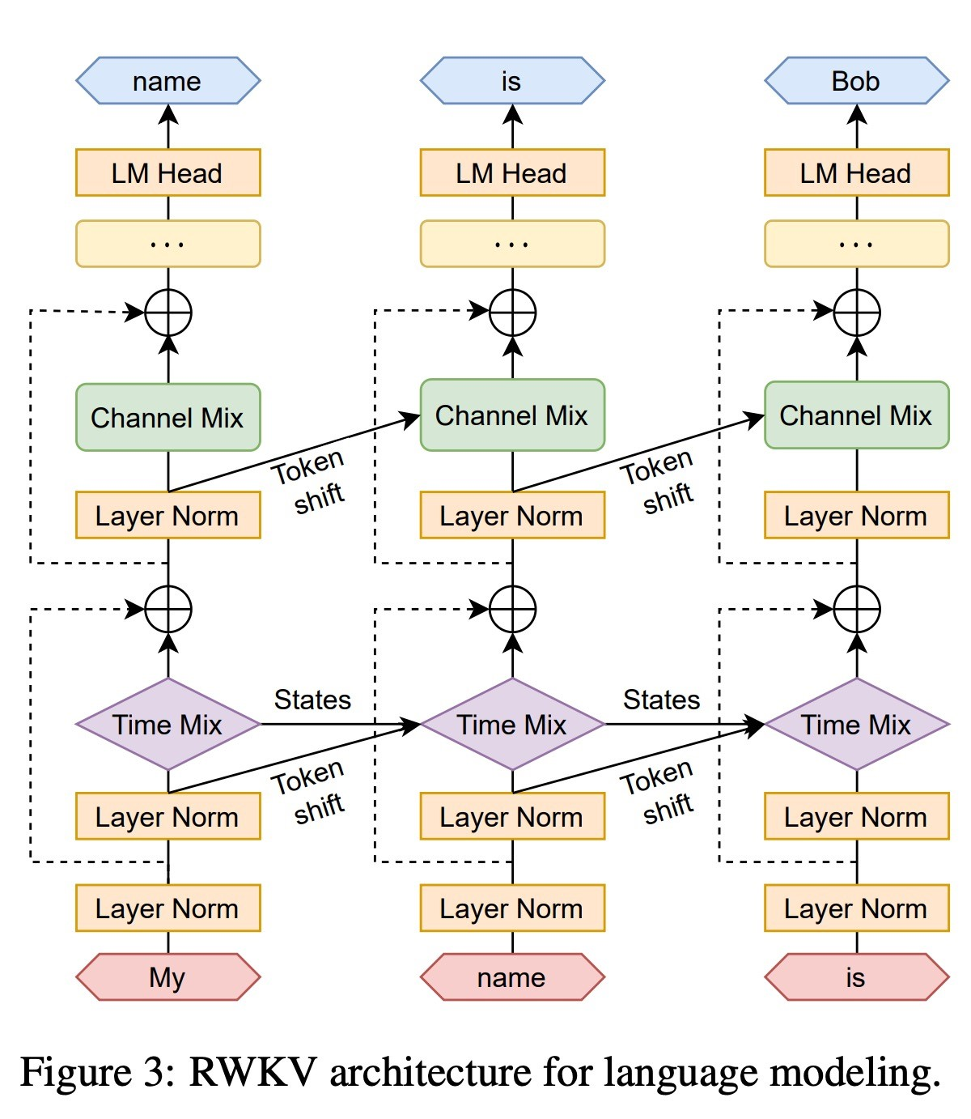
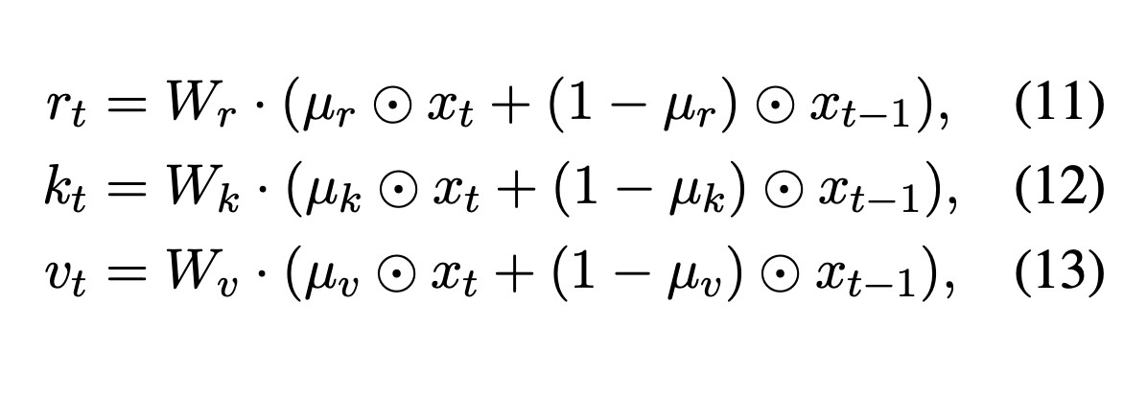
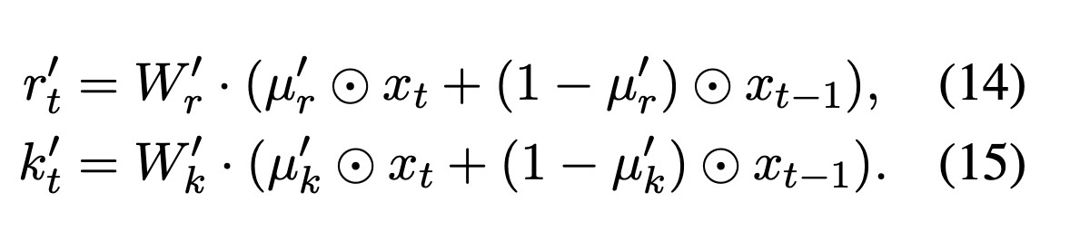
Token shift
• Time mixing
• Channel mixing

Slide 14
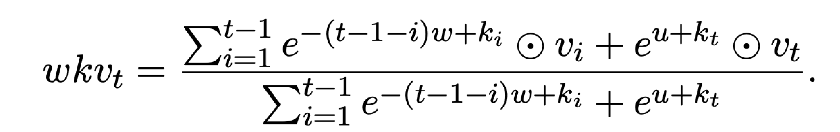
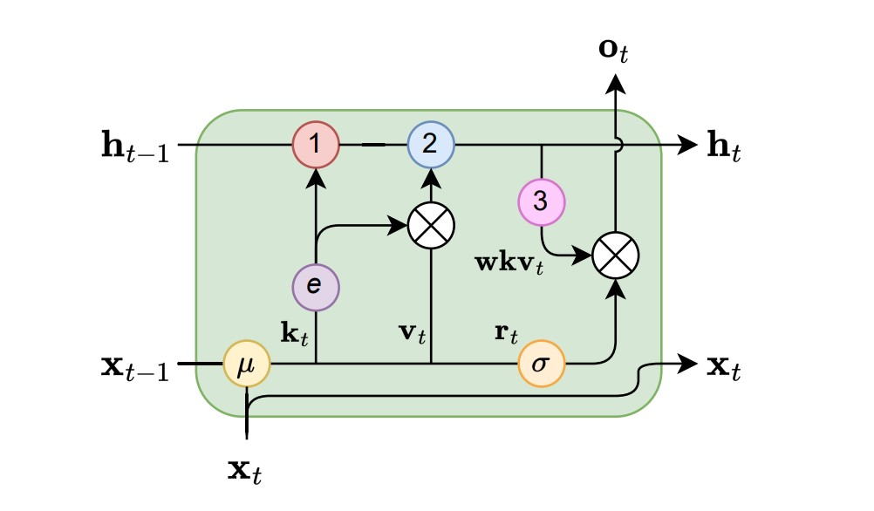
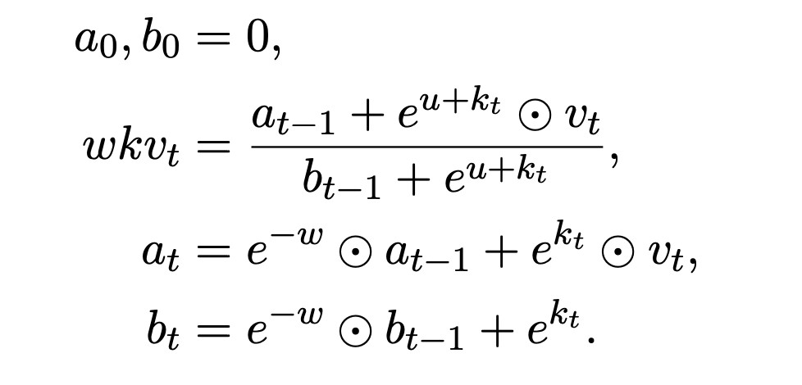
WKV
• （B, L, H）batch size, seq length, hidden size

Slide 15
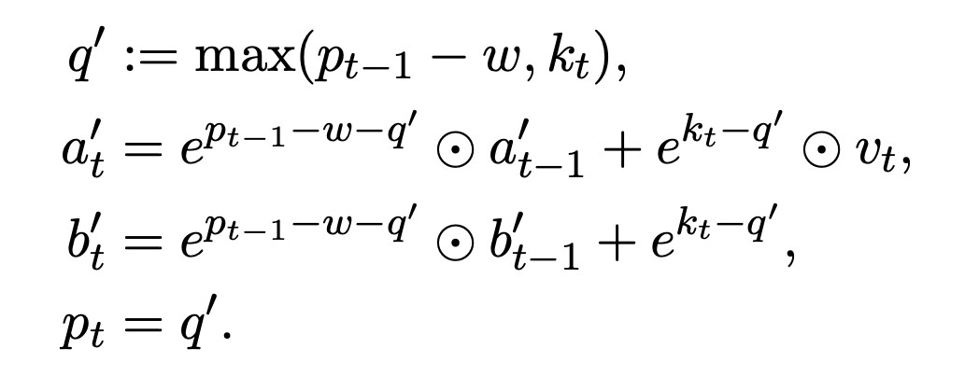
WKV vs LSTM

Slide 16
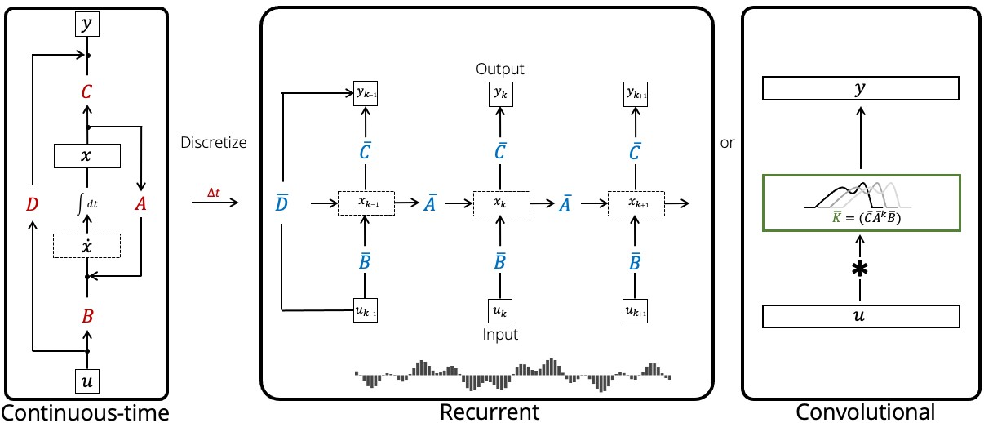
RWKV as CNN
https://zhuanlan.zhihu.com/p/614311961?utm_id=0

Slide 17
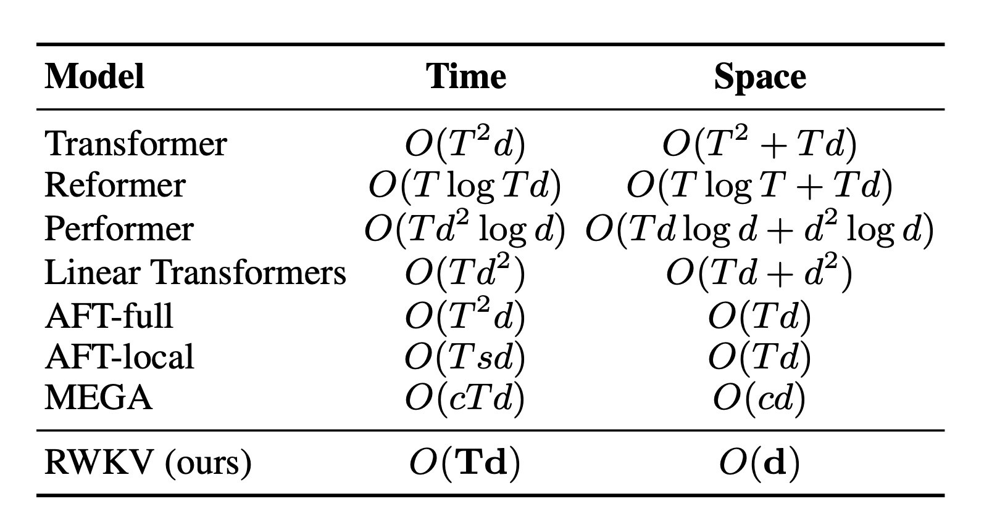
复杂度优化

Slide 18
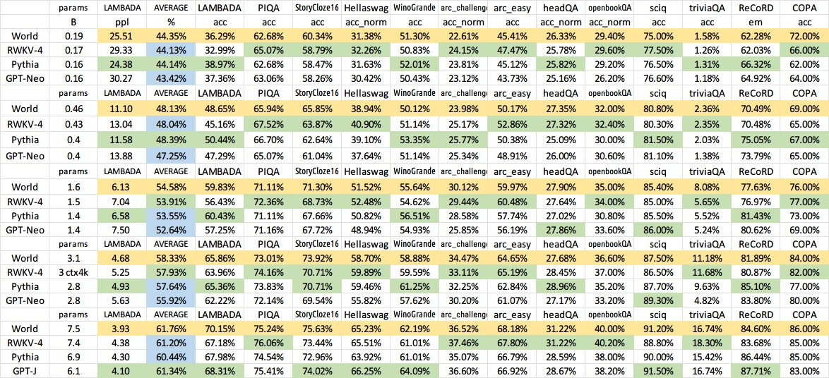
Accuracy对⽐

Slide 19
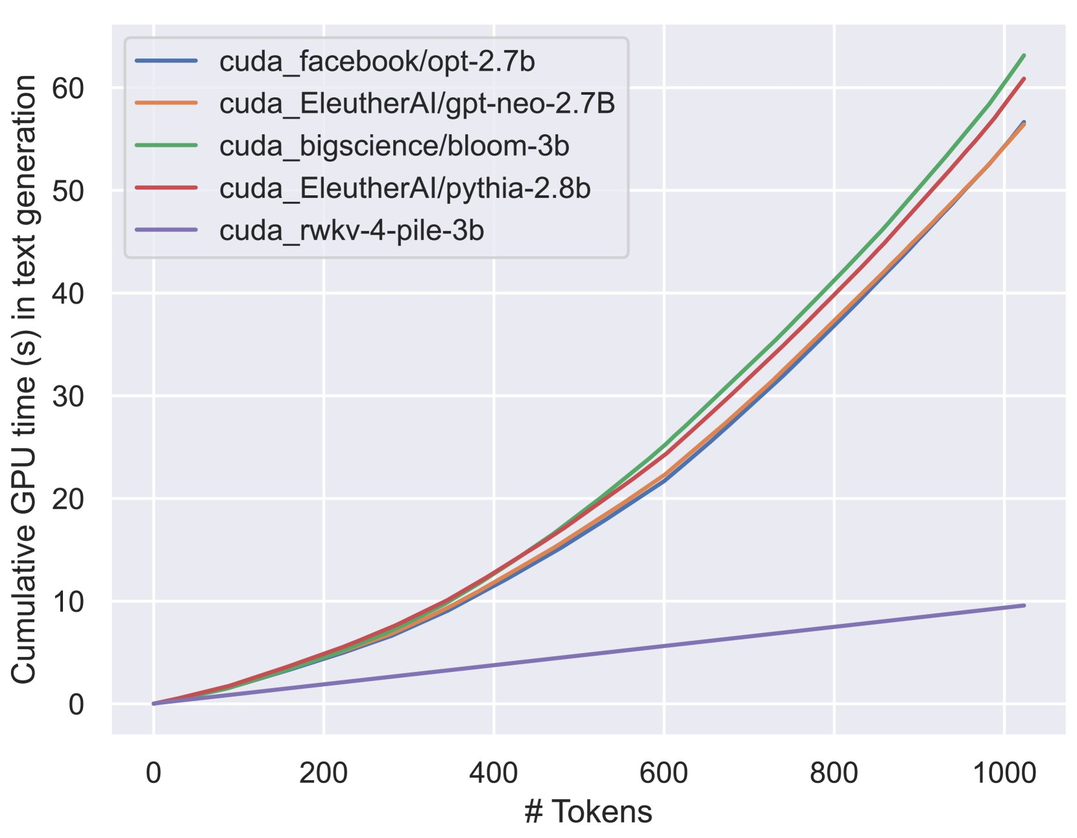
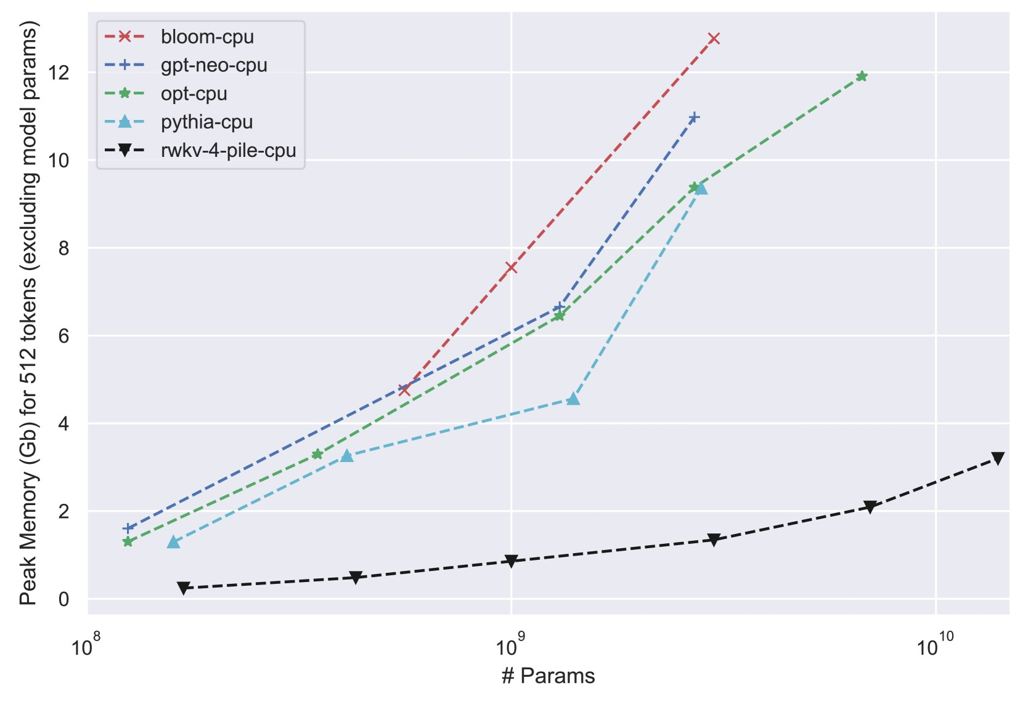
推理速度和内存占⽤

Slide 20
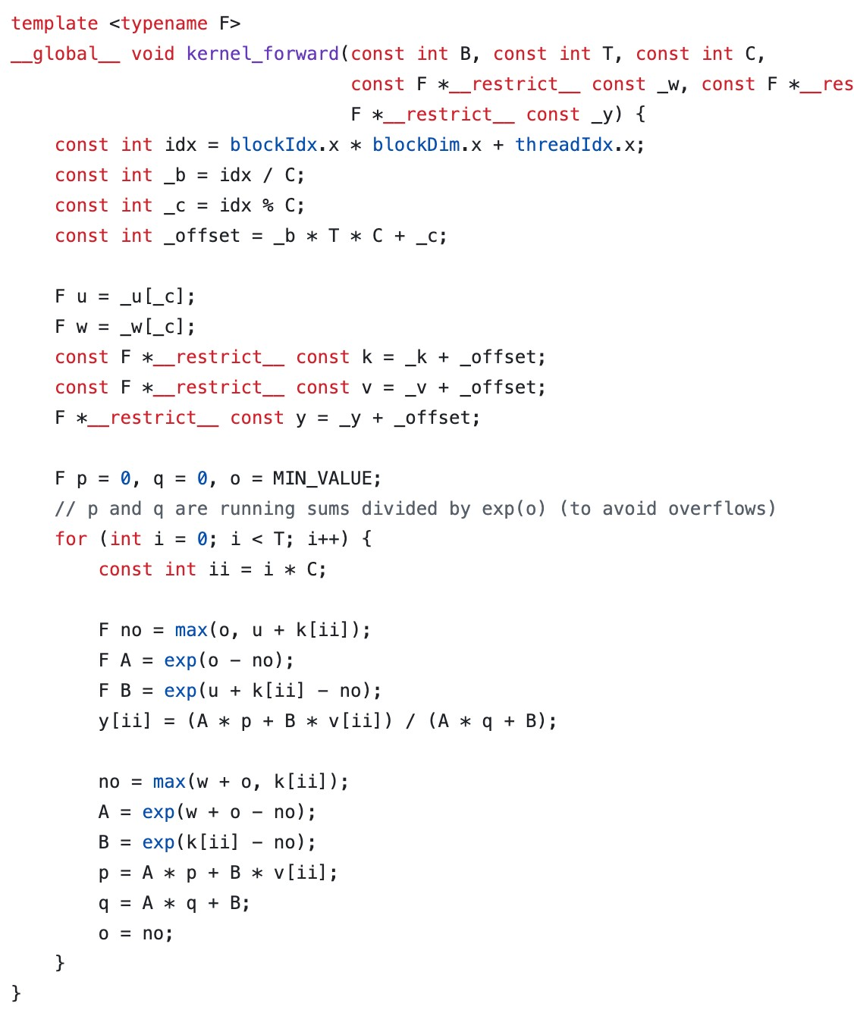
WKV cuda kernel

Slide 21
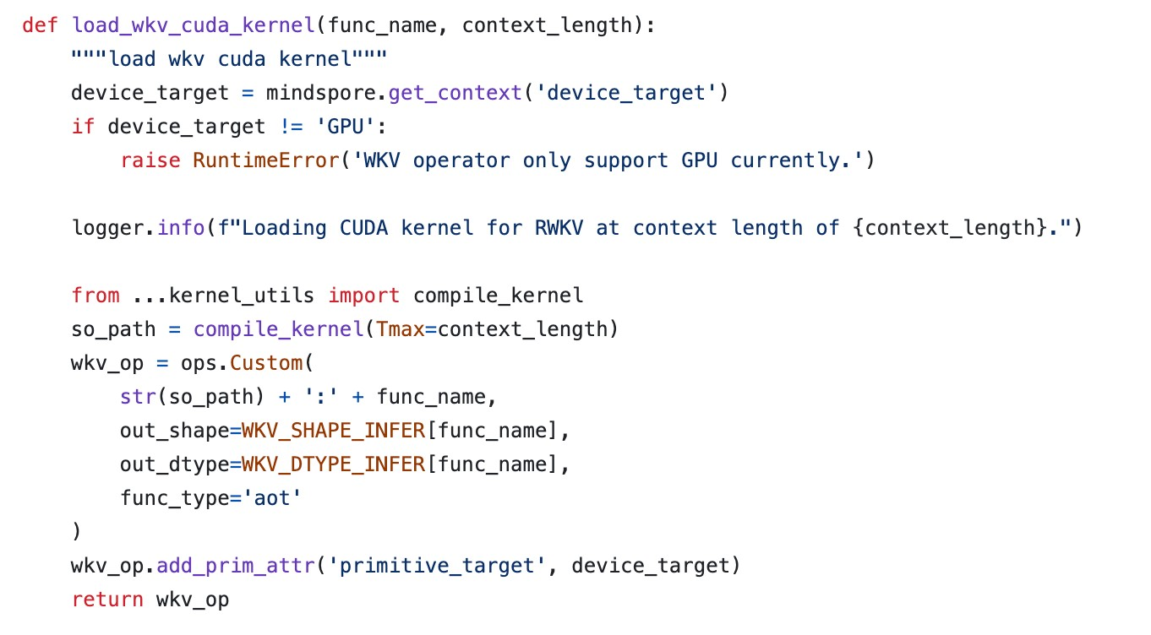
MindSpore custom operator

Slide 22
Huggingface-like demo

